Slide 1
Basic Presentation

Slide 2
Table of contents
Project Overview
Dataset Creation
Overview
Degrees of Freedom
Challenges
TTA and Ensembles
Choice and Setup
Process and Insights
Results - Performance
Slide 9: Future Work
Conclusion

Slide 3
Project Overview
Problem
Creating object detection model using automated annotations.
Objective
Using Florence-2 & Flickr to create dataset for person and pet detection, then train YOLOv8n.
Dataset
964 train, 200 validate images and 4331 annotations.
Project Outcome
Trained model
Code for dataset creation, model training, inference file to create boxed jpg`s.

Slide 4
Engaging the audience
Techniques for connecting
Make eye contact with your audience to create a sense of intimacy and involvement
Weave relatable stories into your presentation using narratives that make your message memorable and impactful
Encourage questions and provide thoughtful responses to enhance audience participation
Use live polls or surveys to gather audience opinions, promoting engagement and making sure the audience feel involved

Slide 5
Engaging the audience
Techniques for connecting
Make eye contact with your audience to create a sense of intimacy and involvement
Weave relatable stories into your presentation using narratives that make your message memorable and impactful
Encourage questions and provide thoughtful responses to enhance audience participation
Use live polls or surveys to gather audience opinions, promoting engagement and making sure the audience feel involved

Slide 6
Engaging the audience
Techniques for connecting
Make eye contact with your audience to create a sense of intimacy and involvement
Weave relatable stories into your presentation using narratives that make your message memorable and impactful
Encourage questions and provide thoughtful responses to enhance audience participation
Use live polls or surveys to gather audience opinions, promoting engagement and making sure the audience feel involved

Slide 7
Engaging the audience
Techniques for connecting
Make eye contact with your audience to create a sense of intimacy and involvement
Weave relatable stories into your presentation using narratives that make your message memorable and impactful
Encourage questions and provide thoughtful responses to enhance audience participation
Use live polls or surveys to gather audience opinions, promoting engagement and making sure the audience feel involved

Slide 8
Engaging the audience
Techniques for connecting
Make eye contact with your audience to create a sense of intimacy and involvement
Weave relatable stories into your presentation using narratives that make your message memorable and impactful
Encourage questions and provide thoughtful responses to enhance audience participation
Use live polls or surveys to gather audience opinions, promoting engagement and making sure the audience feel involved

Slide 9
Engaging the audience
Techniques for connecting
Make eye contact with your audience to create a sense of intimacy and involvement
Weave relatable stories into your presentation using narratives that make your message memorable and impactful
Encourage questions and provide thoughtful responses to enhance audience participation
Use live polls or surveys to gather audience opinions, promoting engagement and making sure the audience feel involved

Slide 10
The Power of Communication

Slide 11
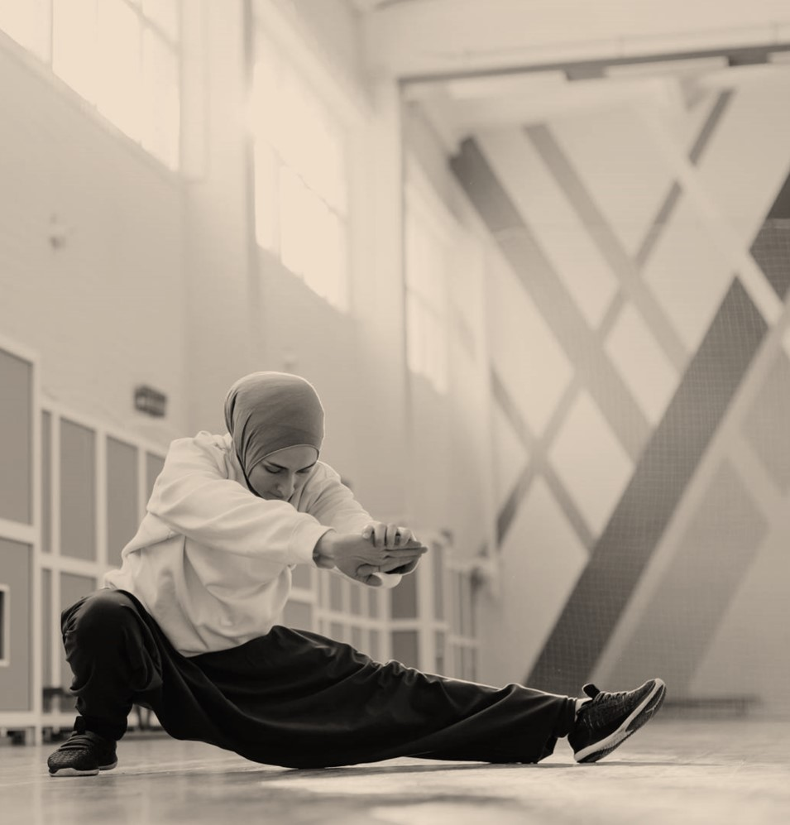
Overcoming nervousness

Slide 12
Engaging the audience
Techniques for connecting
Make eye contact with your audience to create a sense of intimacy and involvement
Weave relatable stories into your presentation using narratives that make your message memorable and impactful
Encourage questions and provide thoughtful responses to enhance audience participation
Use live polls or surveys to gather audience opinions, promoting engagement and making sure the audience feel involved

Slide 13
Selecting Visual Aids

Slide 14
Effective delivery techniques
Voice modulation
Body language
This is a powerful tool in public speaking. It involves varying pitch, tone, and volume to convey emotion, emphasize points, and maintain interest:
Pitch variation
Tone inflection
Volume control
Effective body language enhances your message, making it more impactful and memorable:
Meaningful eye contact
Purposeful gestures
Maintain good posture
Control your expressions

Slide 15
Navigating Q&A Sessions
Preparing for questions
Maintaining composure
Know your material in advance
Anticipate common questions
Rehearse your responses
Maintaining composure during the Q&A session is essential for projecting confidence and authority. Consider the following tips for staying composed:
Stay calm
Actively listen
Pause and reflect
Maintain eye contact

Slide 16

Speaking Impact
Your ability to communicate effectively will leave a lasting impact on your audience
Effectively communicating involves not only delivering a message but also resonating with the experiences, values, and emotions of those listening

Slide 17
Dynamic delivery
METRIC | MEASUREMENT | TARGET | ACTUAL
Audience attendance | # of attendees | 150 | 120
Engagement duration | Minutes | 60 | 75
Q&A interaction | # of questions | 10 | 15
Positive feedback | Percentage (%) | 90 | 95
Rate of information retention | Percentage (%) | 80 | 85
Learn to infuse energy into your delivery to leave a lasting impression
One of the goals of effective communication is to motivate your audience

Slide 18
Final tips & takeaways
Practice makes perfect
Continue improving
Consistent rehearsal
Strengthen your familiarity
Refine delivery style
Pacing, tone, and emphasis
Timing and transitions
Aim for seamless, professional delivery
Practice audience
Enlist colleagues to listen & provide feedback
Seek feedback
Reflect on performance
Explore new techniques
Set personal goals
Iterate and adapt

Slide 19
Speaking engagement metrics
IMPACT FACTOR | MEASUREMENT | TARGET | ACHIEVED
Audience interaction | Percentage (%) | 85 | 88
Knowledge retention | Percentage (%) | 75 | 80
Post-presentation surveys | Average rating | 4.2 | 4.5
Referral rate | Percentage (%) | 10 | 12
Collaboration opportunities | # of opportunities | 8 | 10

Slide 20
THANK YOU
Brita Tamm
502-555-0152
brita@firstupconsultants.com
www.firstupconsultants.com

